Slide 1






CellID: A Brief story about single cell data analysis and methods development; its joy and its frustration from the perspective of a 3rd year PhD Student.
Journée Toulousaine Single Cell RNASeq (2e Journée)
Toulouse, 4th July 2019
Akira Cortal
PhD Student in Bioinformatics
Dr. Antonio Rausell Clinical Bioinformatics Lab

Slide 2
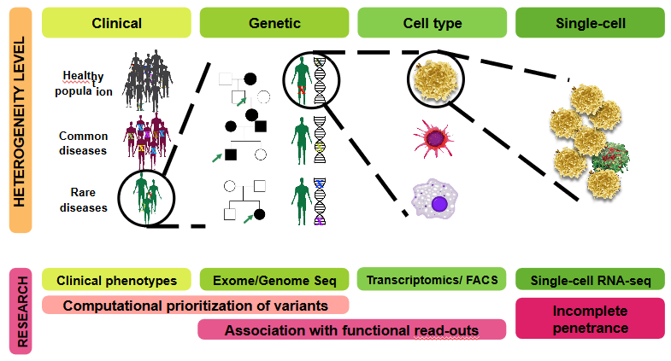
Imagine Clinical Bioinformatics Lab: Functional assessment of rare genetic variants in rare human genetic disease

Slide 3
1.
Single Cell, the Good Part

Slide 4
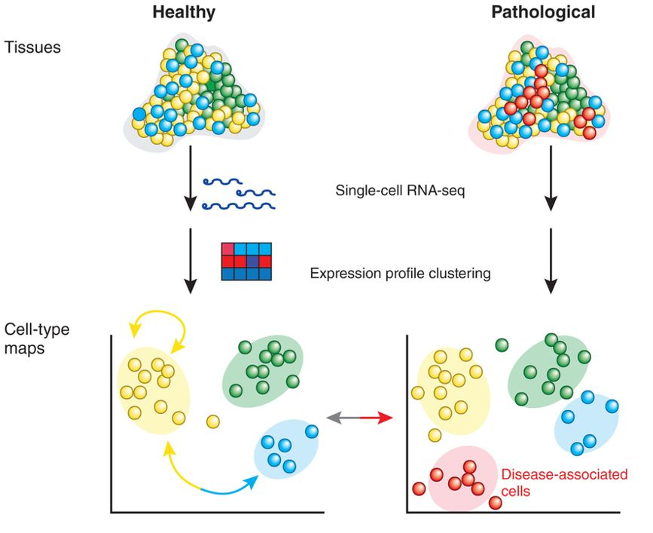
The Wonder of Single Cell: Resolution
Standard RNA-Seq:
Each Sample is a tissue/group of cells.
Allows only comparison between tissues.
Single Cell RNA-Seq:
Each sample is a individual cells.
Allows higher resolution comparison

Slide 5


The Wonder of Single Cell: Resolution
From Bulk …
…To Single Cell

Slide 6
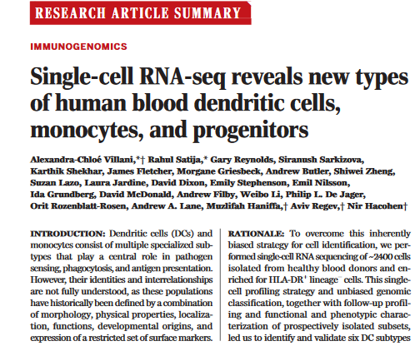
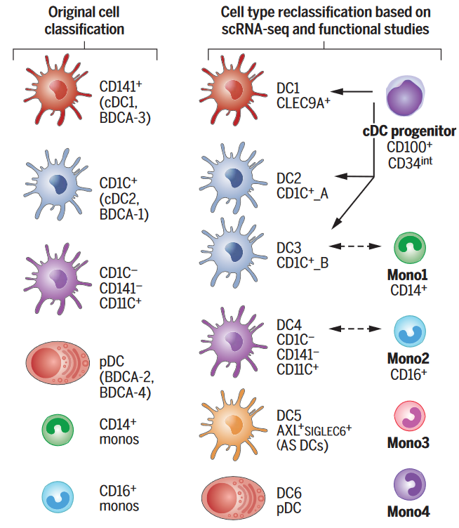
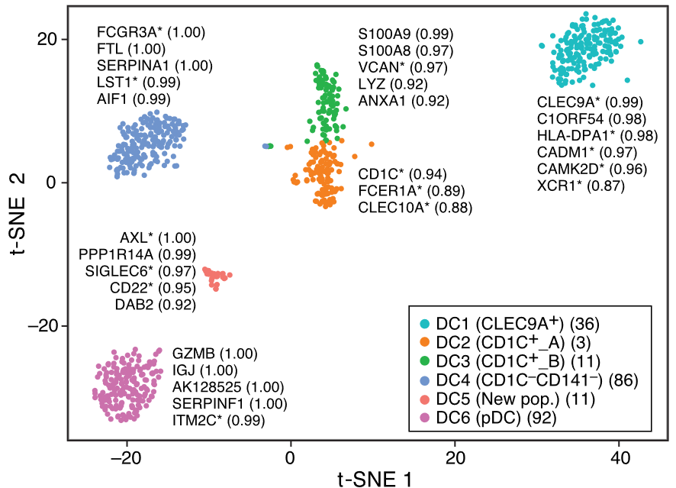
Rare Sub-Populations Discovery: Monocytes and DC
Villani et Al(2017). Single-cell RNA-seq reveals new types of human blood dendritic cells, monocytes, and progenitors. Science

Slide 7
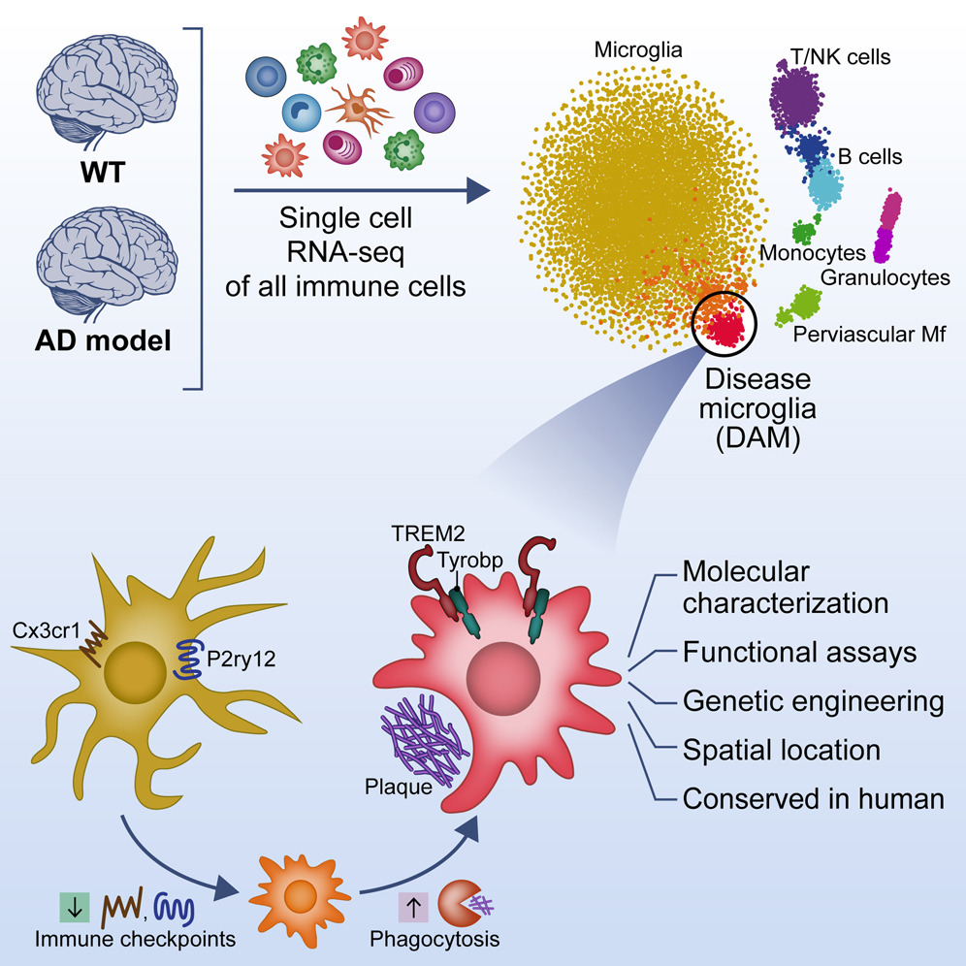
Transcriptomic lanscape of disease.
Sequencing of Wild Type and Alzheimer disease model mouse.
Detection of a specific compartment of microglia related with Alzheimer disease (only found in Alzheimer model mouse).
Identification of genes characterising these cells.
Identification of pathways upregulated in these cells. (lipidic metabolism)
Keren-Shaul et al. - 2017 - A Unique Microglia Type Associated with Restricting Development of Alzheimer’s Disease

Slide 8
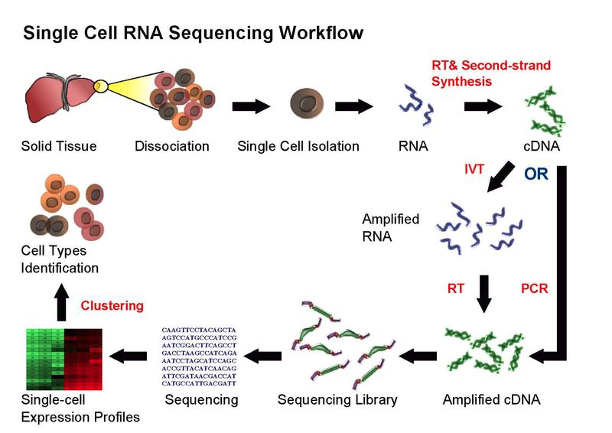
Workflow of Single Cell RNA-Seq

Slide 9
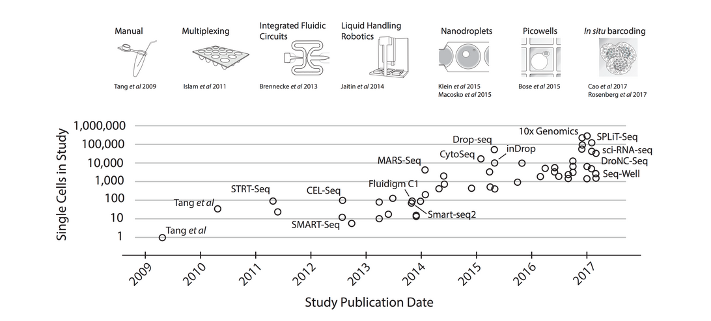
The Wonder of Single Cell: Resolution
Exponential scaling of single-cell RNA-seq in the last decade, Svenson et al 2017

Slide 10
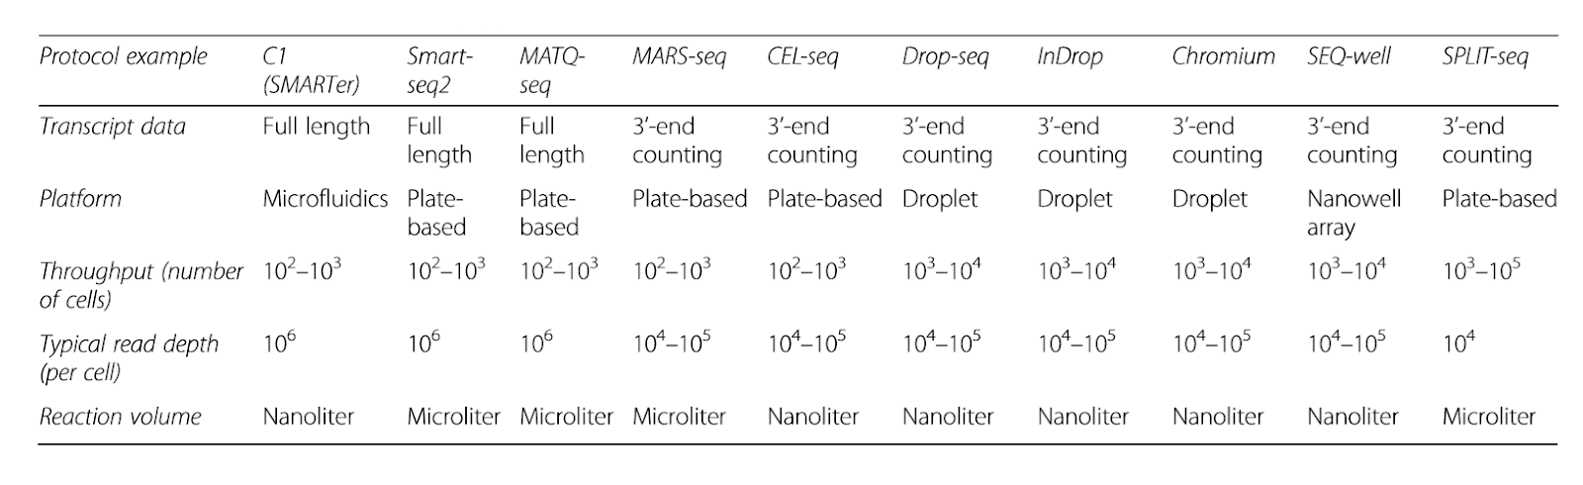
The Wonder of Single Cell: Resolution
Exponential scaling of single-cell RNA-seq in the last decade, Svenson et al 2017

Slide 11
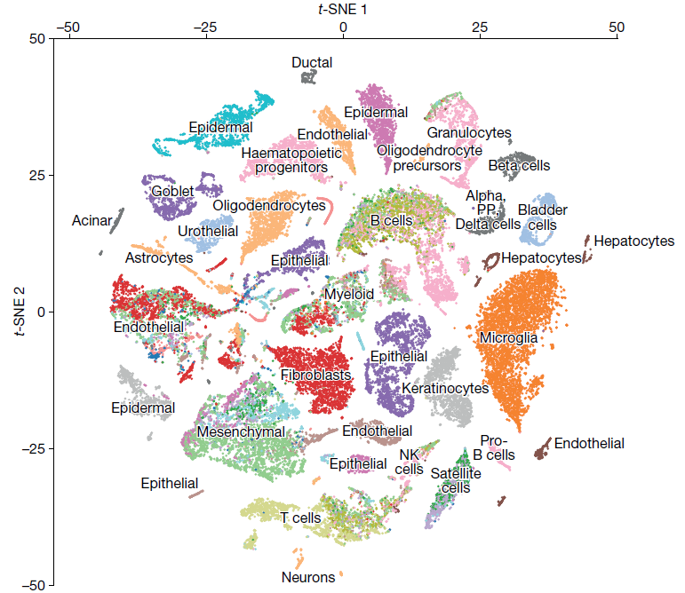
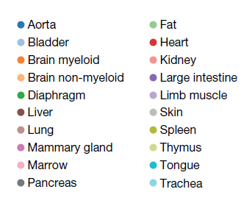
Repertoring Whole Organism: with SC: Tabula Muris
Tabula, T., & Consortium, M. (2018). Single-cell transcriptomics of 20 mouse organs creates a Tabula Muris

Slide 12

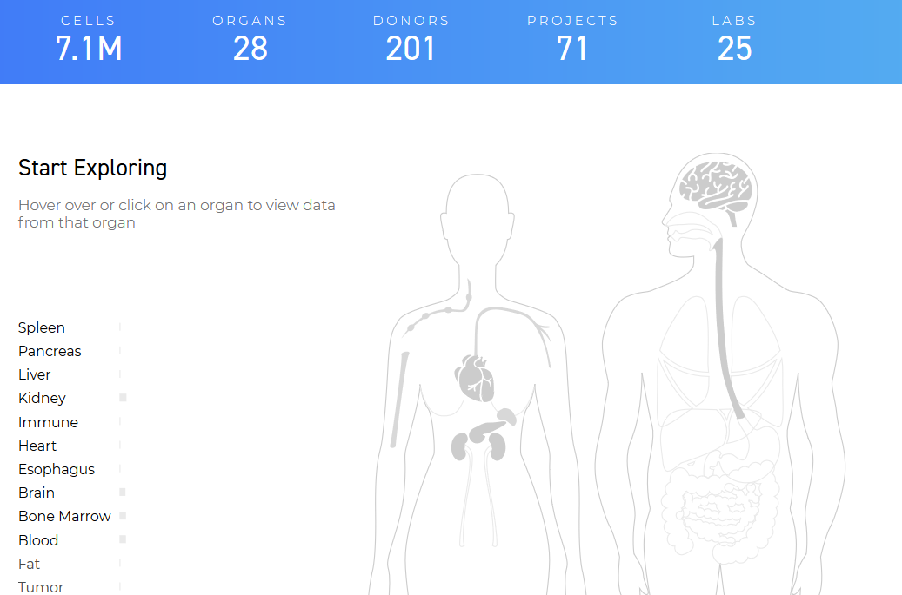
Repertoring Whole Organism: with SC: HCA
https://dev.data.humancellatlas.org/
Data programmatically available using the Bioconductor packages HCABrowser and HCAData
https://www.bioconductor.org/packages/release/bioc/html/HCABrowser.html
https://www.bioconductor.org/packages/release/data/experiment/html/HCAData.html

Slide 13
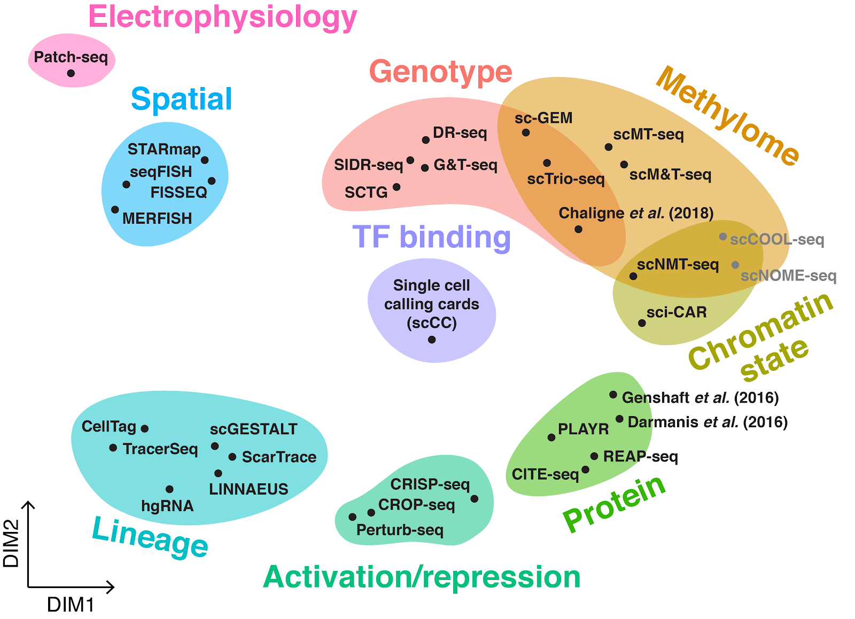
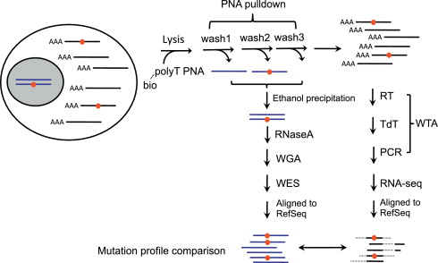
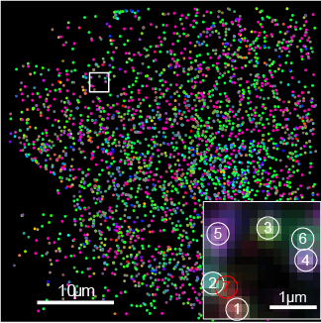
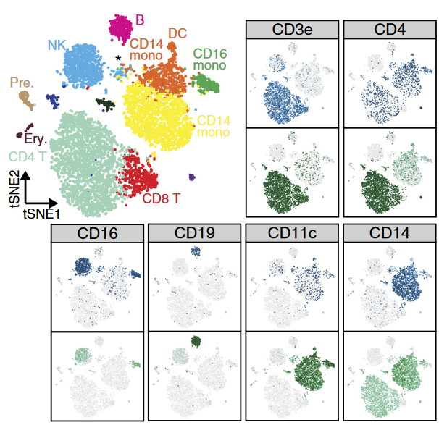
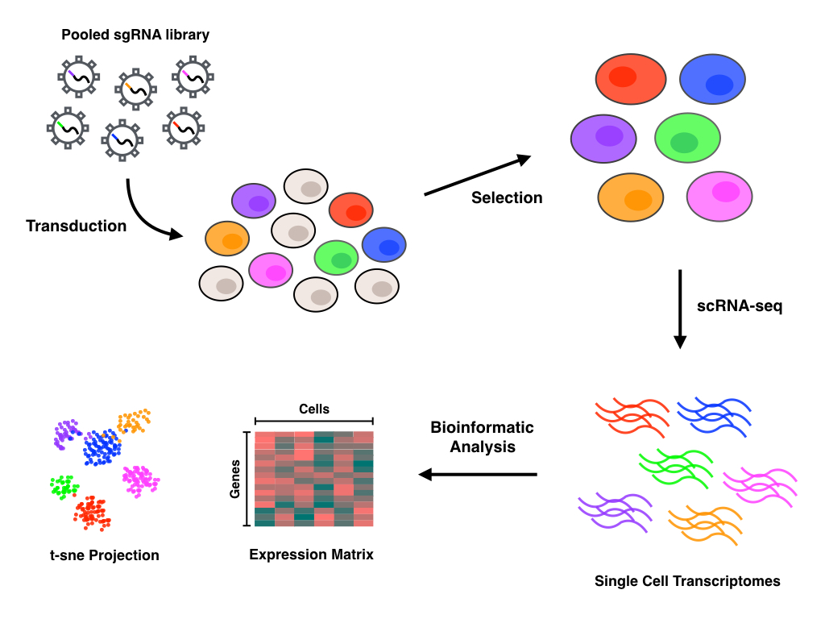
The Wonder of Single Cell: Concurrent Sequencing of other OMICS

Slide 14

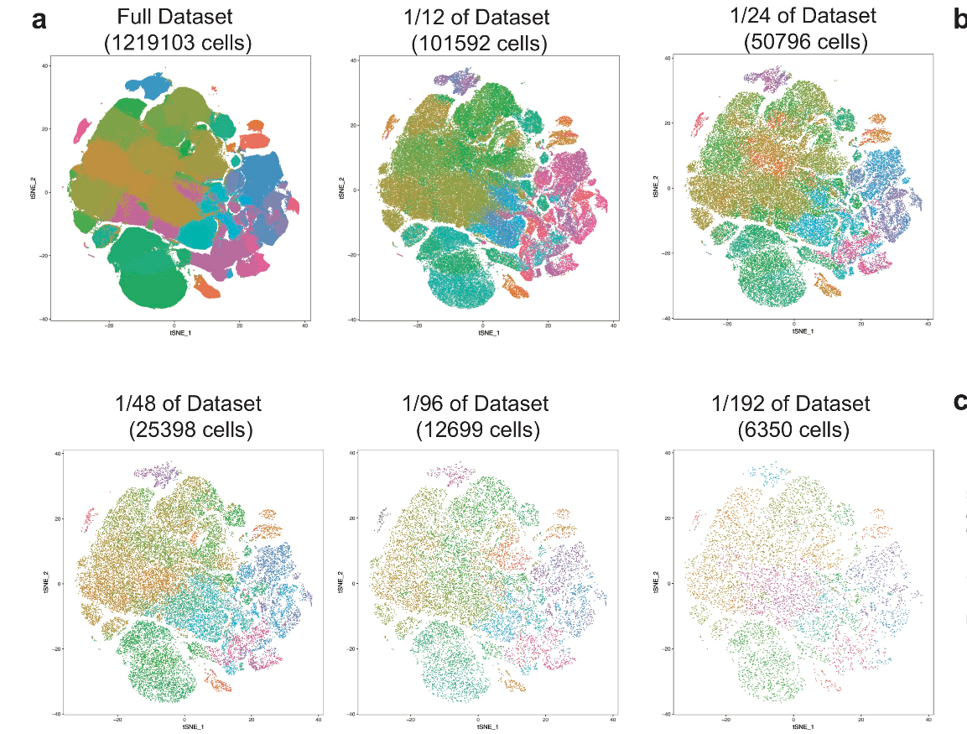
The Wonder of Single Cell: Maybe too much cells?

Slide 15


The Wonder of Single Cell: Maybe too much cells?
2016
2019

Slide 16
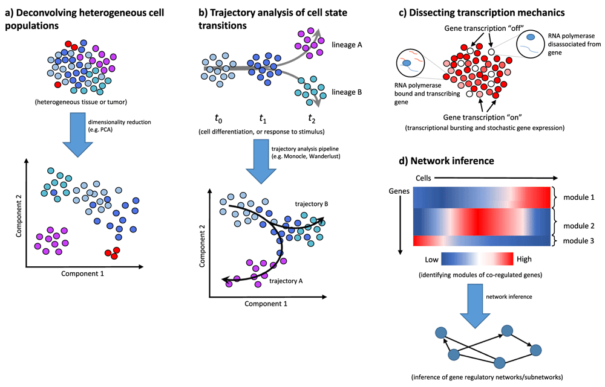
The Wonder of Single Cell: Diverse Applications

Slide 17
2.
Single Cell, the Bad Part

Slide 18

The Challenges of Single Cell
Lower coverage/depth than bulk RNA-seq
Technical & biological noise (Batch effect)
High dimensionality
High variability
Zero-inflated data
Multimodality

Slide 19
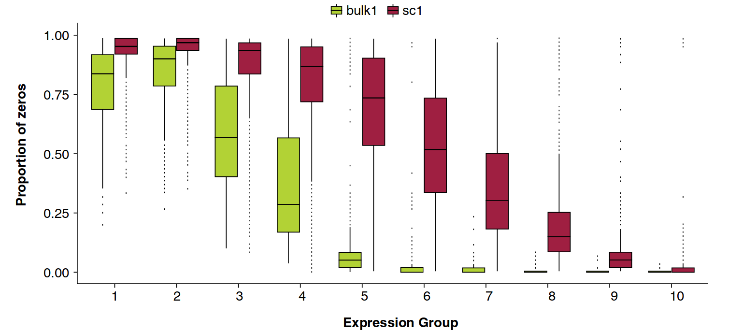
The Challenges of Single Cell: Resolution
Much more zero in single cell data.
Drop Out Effect
Genes expressed in few cells
Genes expressed in most cells
Bacher and Kendziorski Genome Biology (2016) 17:63

Slide 20
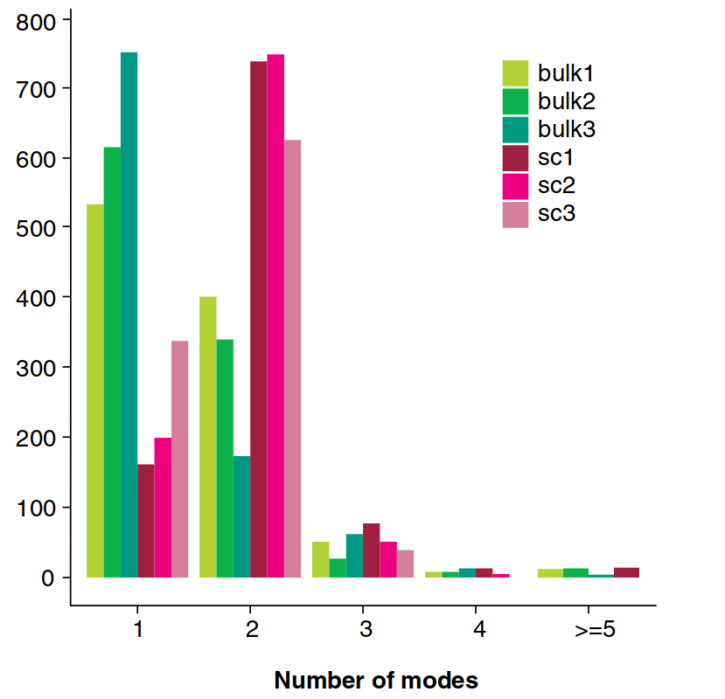
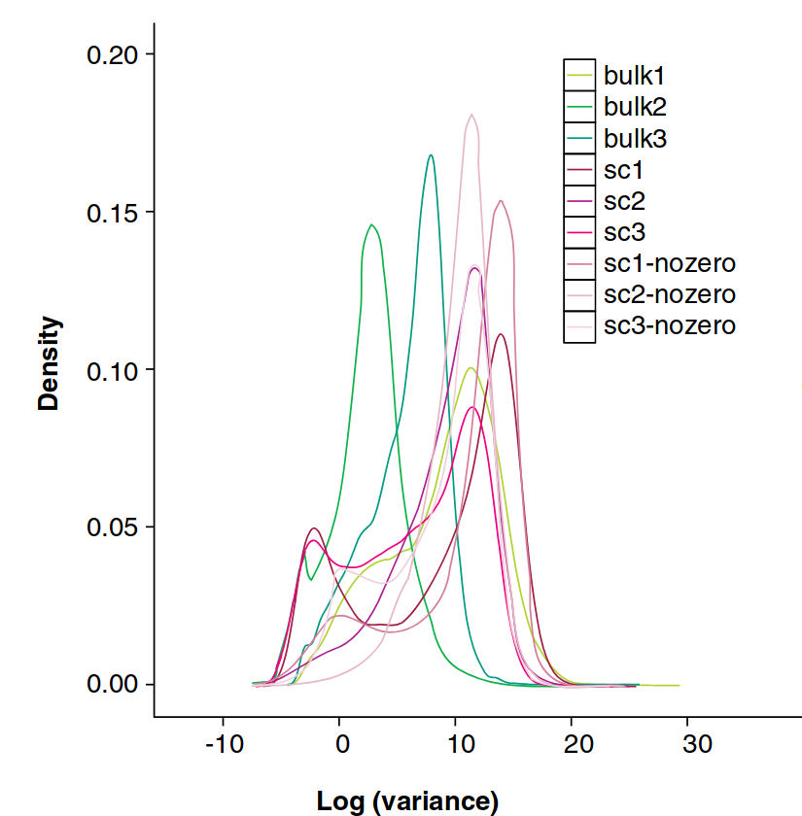
The Challenges of Single Cell: Multimodality of gene expression
Bacher and Kendziorski Genome Biology (2016) 17:63

Slide 21
The Challenges of Single Cell: Concurrent Sequencing of other OMICS

Slide 22

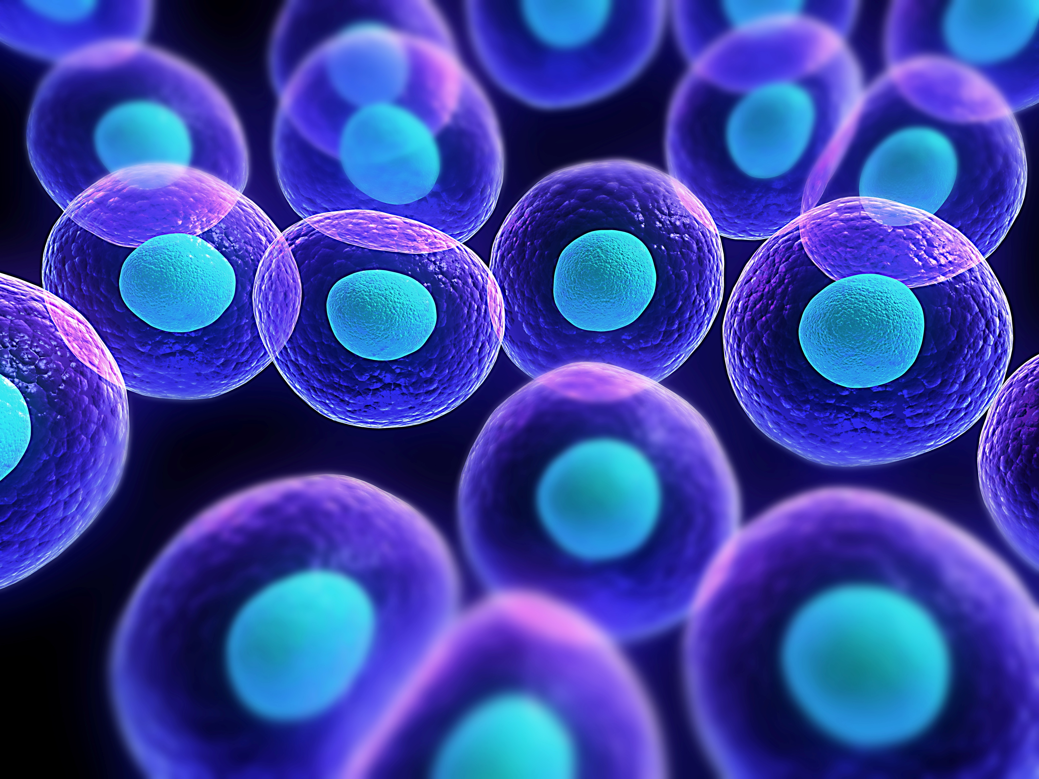

The Challenges of Single Cell : About Hardware…
Your Typical Laptop
with <16Gb of Ram
Your Results
50 000 cells

Slide 23

The Challenges of Single Cell : About Hardware…
Workstation/ Server
32Gb > Ram
Your Results
50 000 cells

Slide 24
3.
Methods, Tools and Software

Slide 25
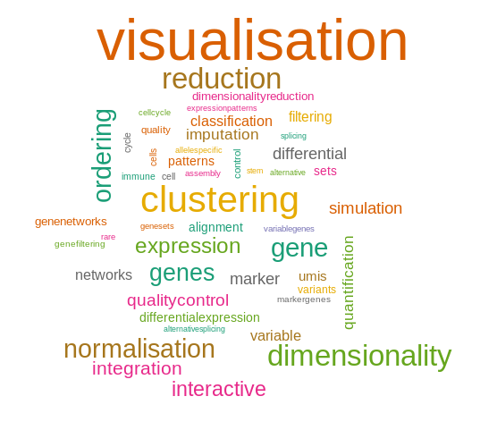
SC data analysis
Many different aspect in single cell analysis.

Slide 26
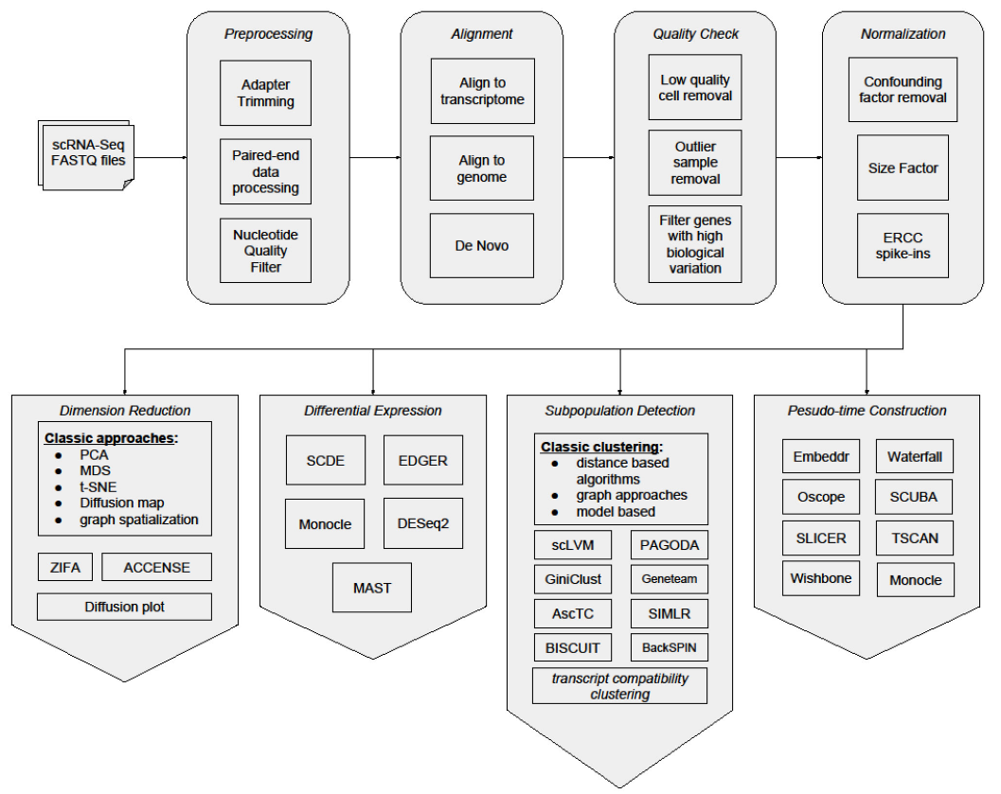
SC data analysis: Basic workflow
Downstream Analysis
Upstream Analysis

Slide 27
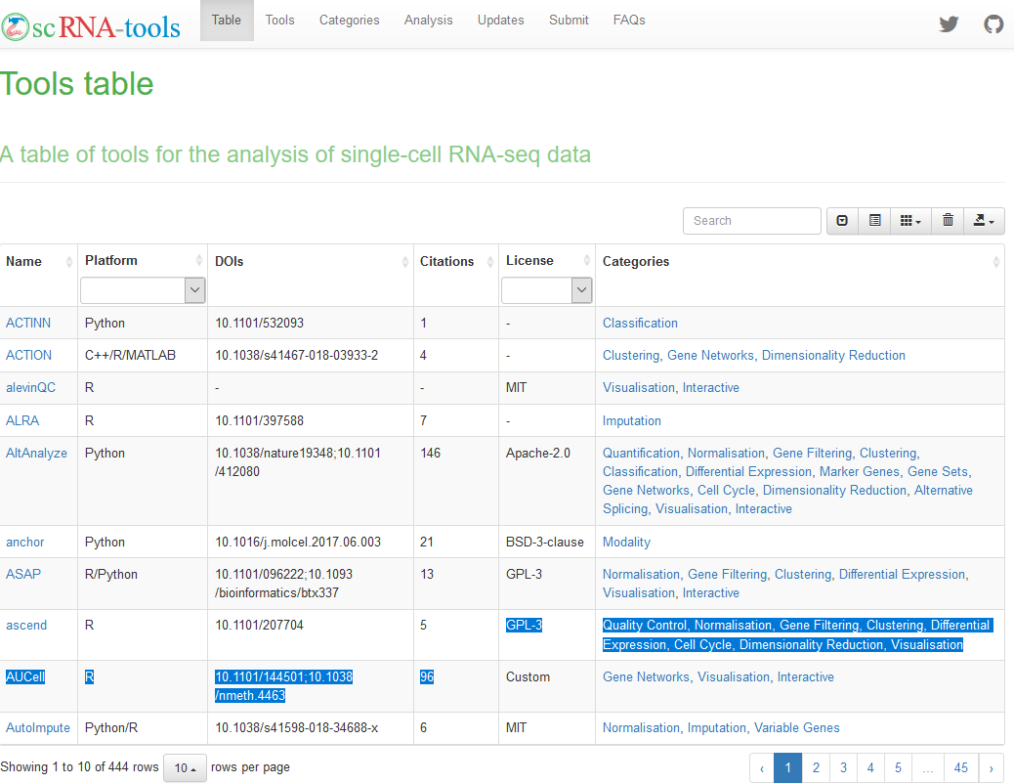
SC data analysis: tools and software
scRNA-tools:
Database of tools available for single cell data analysis.
Currently 444 different tools listed for both upstream analysis and downstream.

Slide 28




Analysis methods: All in one Pipelines
https://satijalab.org/seurat/
https://scanpy.readthedocs.io/en/stable/

Slide 29
4.
Dimensionality Reduction

Slide 30
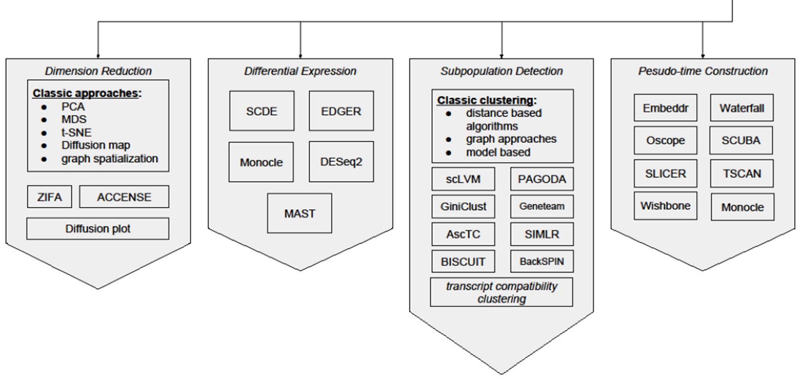
Single Cell Data Analysis: Dimensionality Reduction

Slide 31
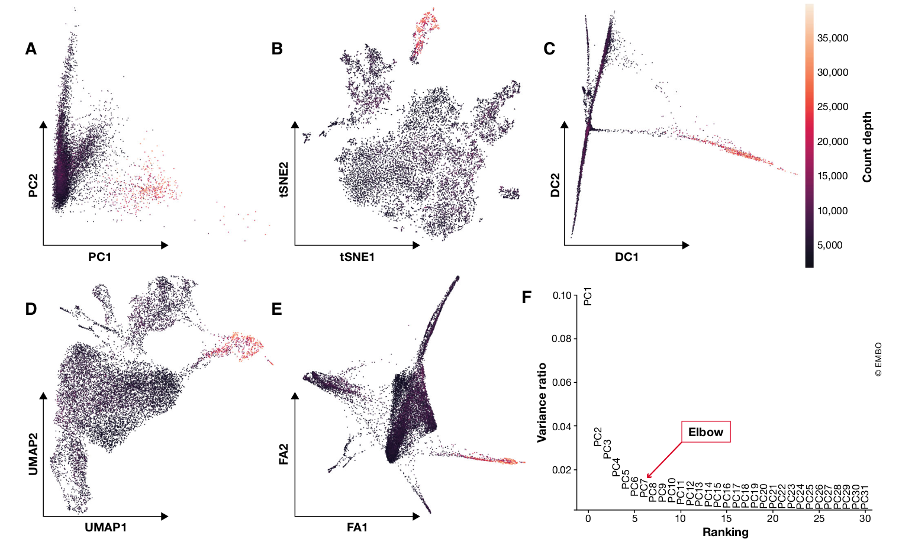
Dimensionality Reduction: Many techniques, but mainly for visualisation
A PCA
B tSNE
C Diffusion Map
D UMAP
E Force Atlas
F Variance Explained by Each principal components

Slide 32
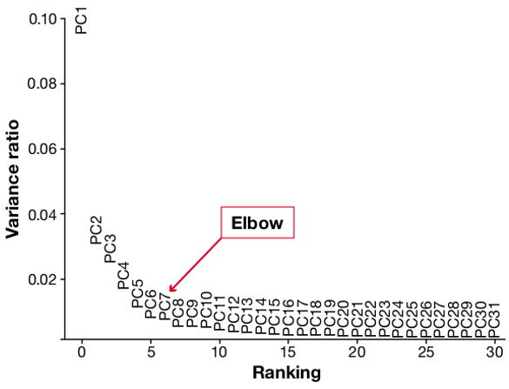
Dimensionality Reduction: Choosing the number of components.
Always the problem of how many
Components to retain.

Slide 33
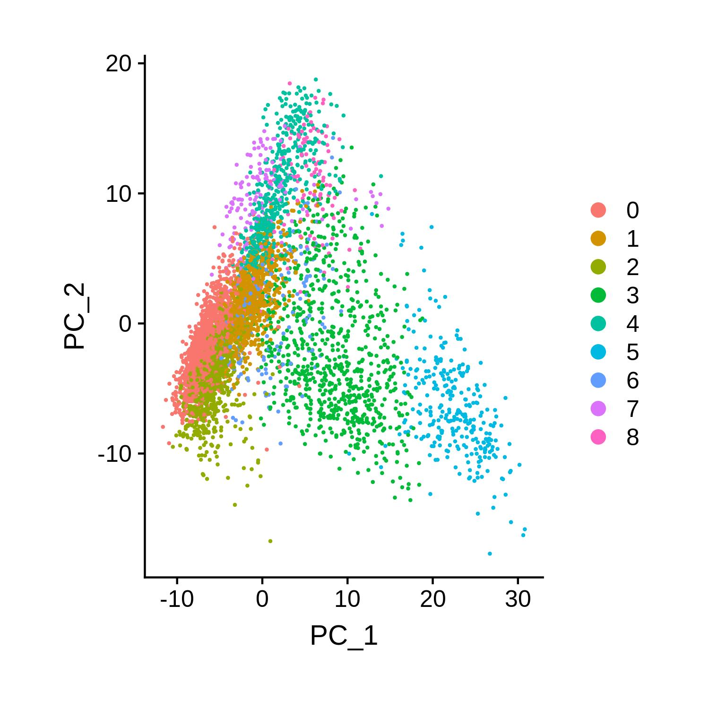
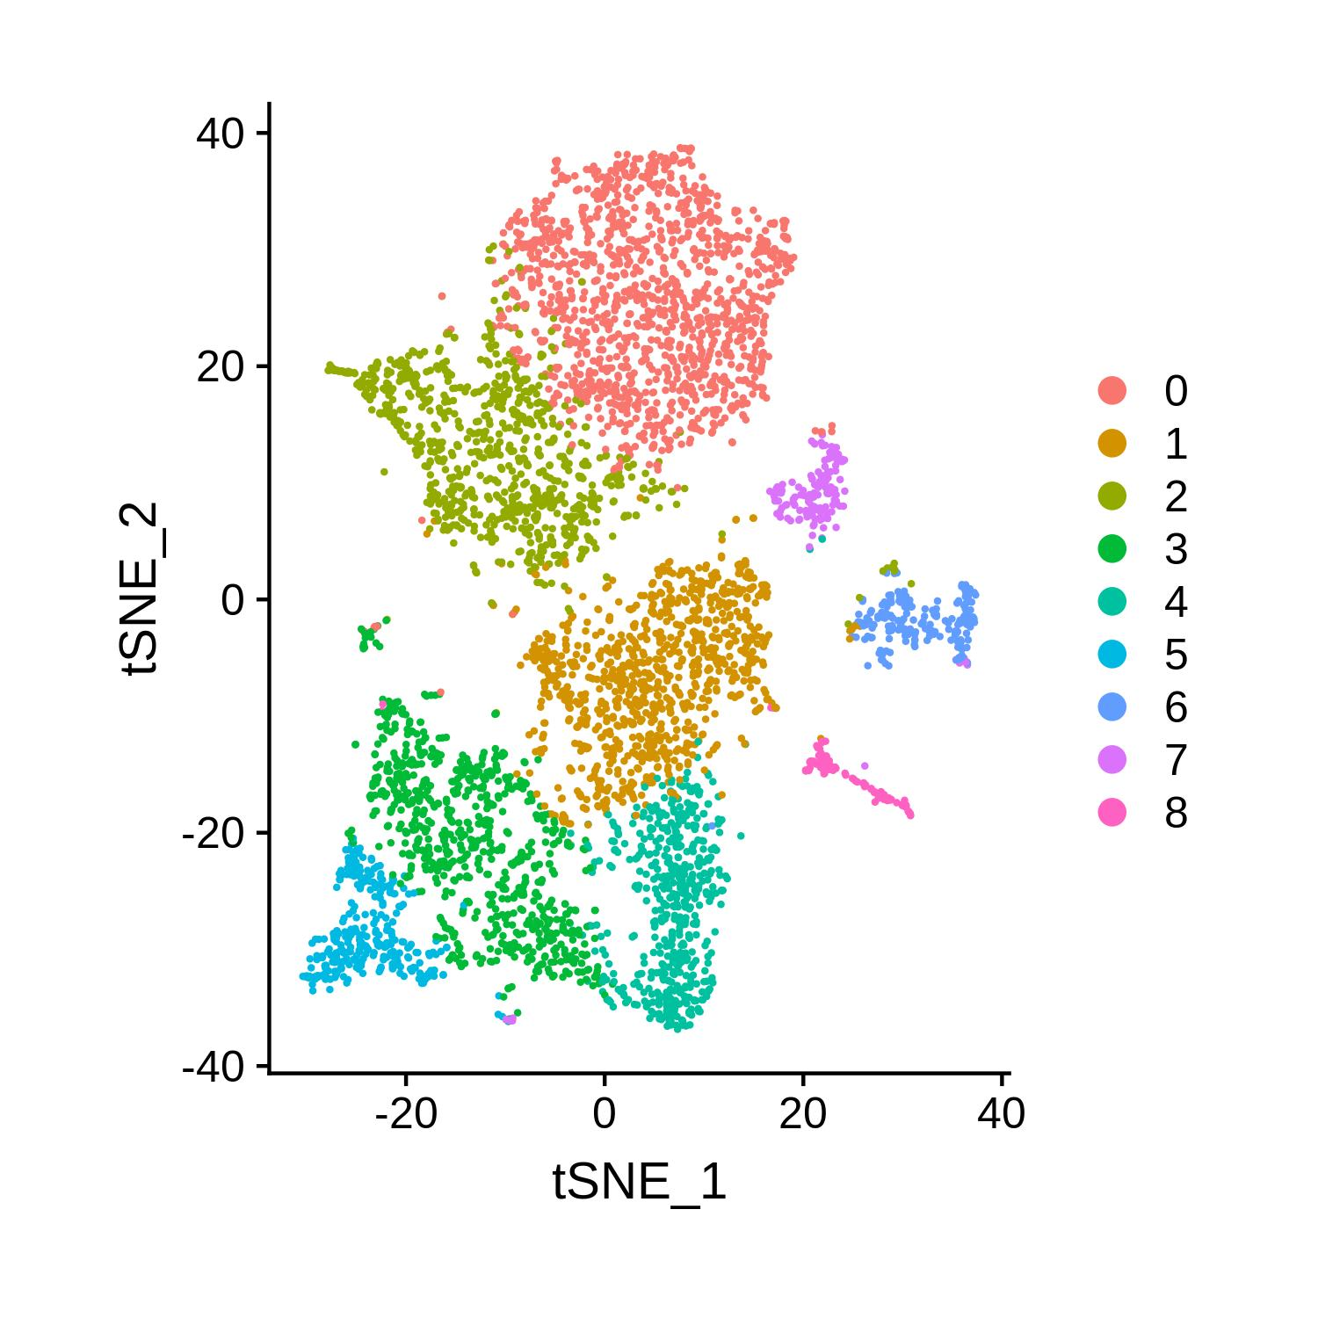
2D representation of single cell data tSNE
Better Visualisation in 2D than PCA

Slide 34
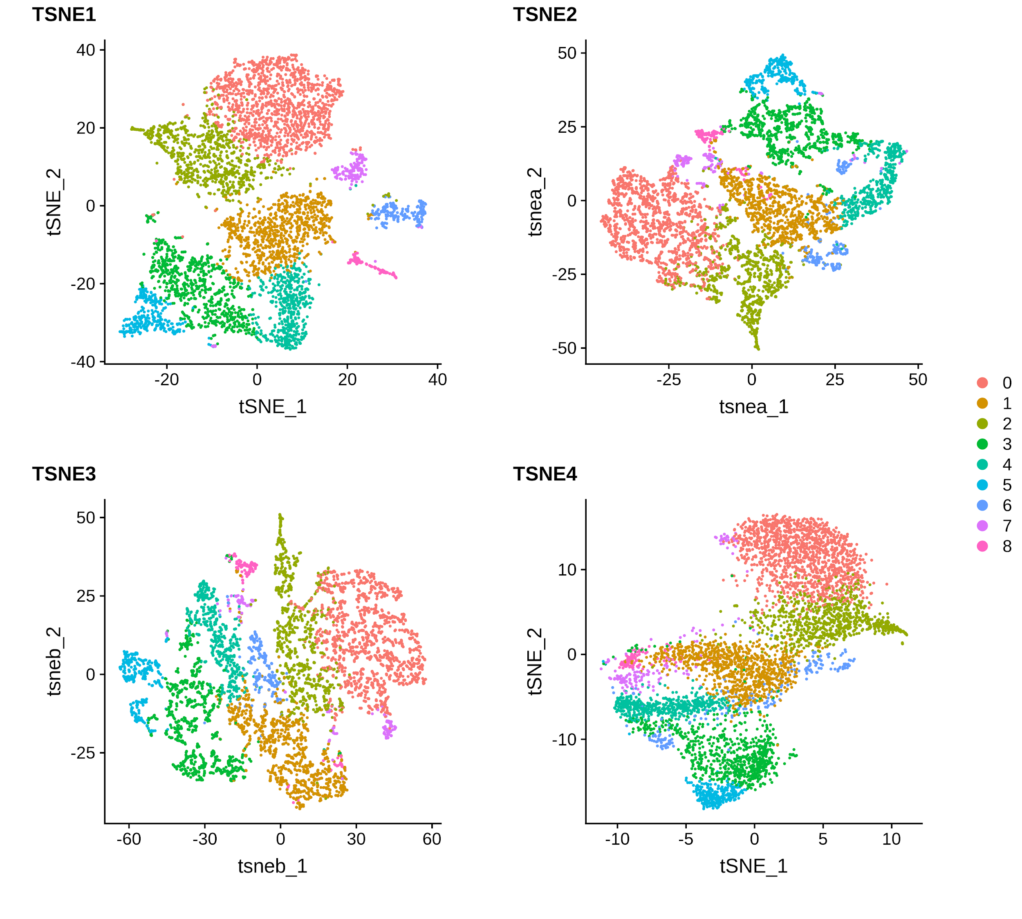
2D representation of single cell data tSNE
Lots of hyperparameter.
Stochastic (different results every run)
Doesn’t respect large scale structure.

Slide 35
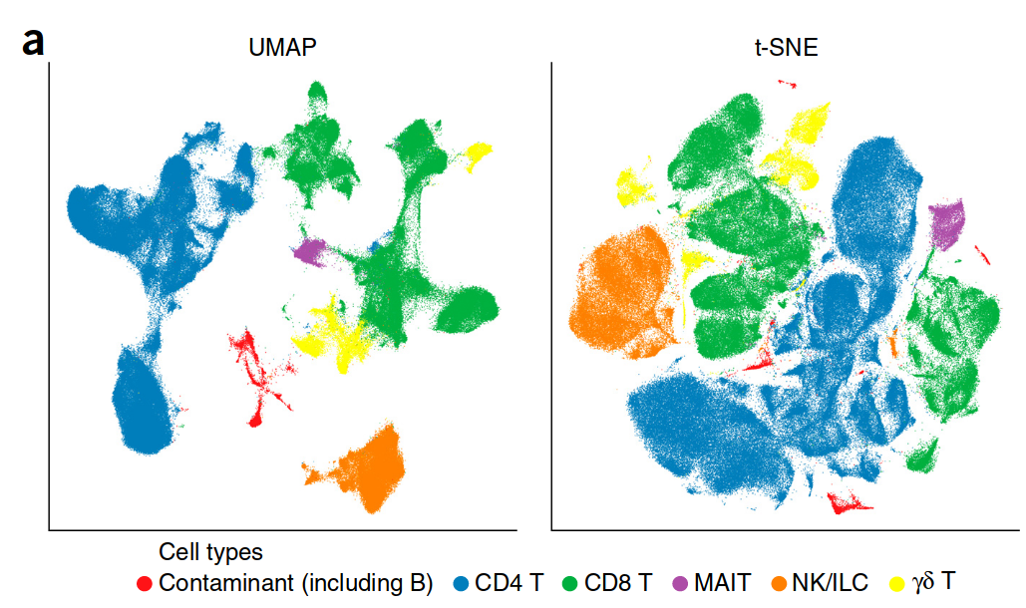
A more robust 2D Representation UMAP
Claimed to preserve the local and the global data structure more than t-SNE
Shorter run time.
Dimensionality reduction for visualizing single-cell data using UMAP Becht et al. Nature Biotechnology 2018. http://www.nature.com/doifinder/10.1038/nbt.4314

Slide 36
5.
Clustering

Slide 37
Single Cell Data Analysis: Clustering

Slide 38
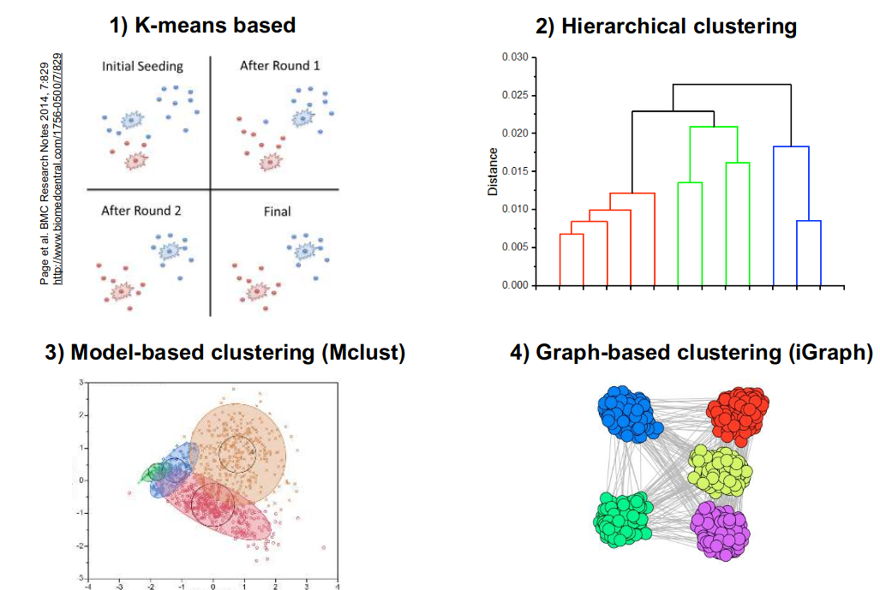
Clustering methods: Basic methods

Slide 39
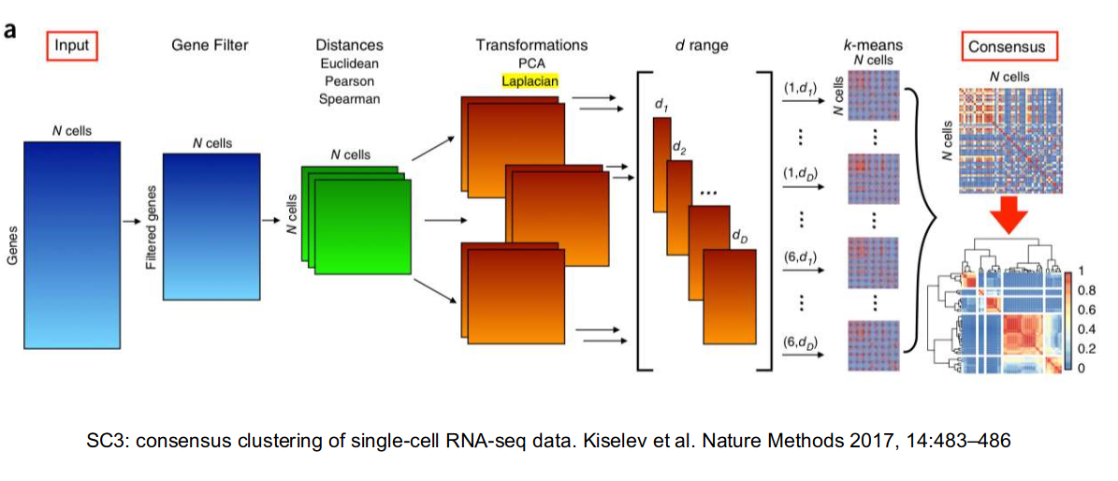
An Example of Single Cell clustering methods: SC3

Slide 40
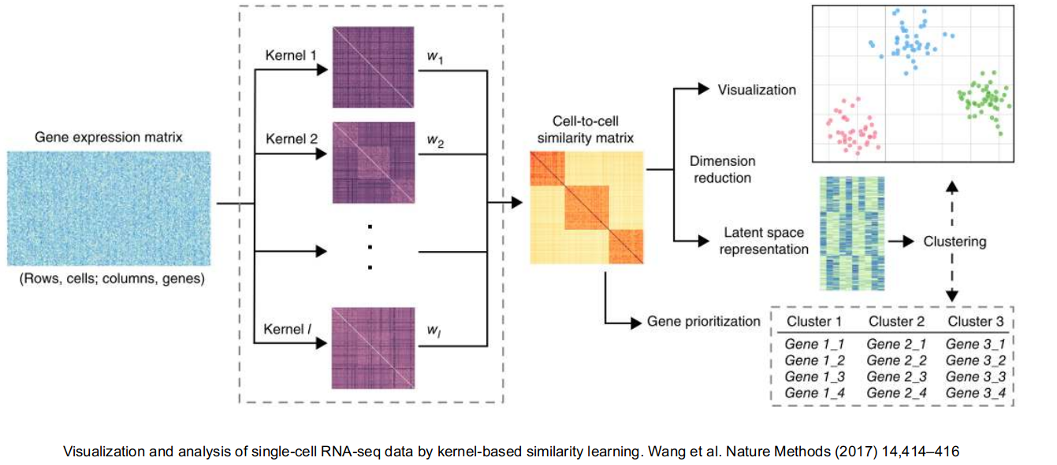
An Example of Single Cell clustering methods: SIMLR

Slide 41
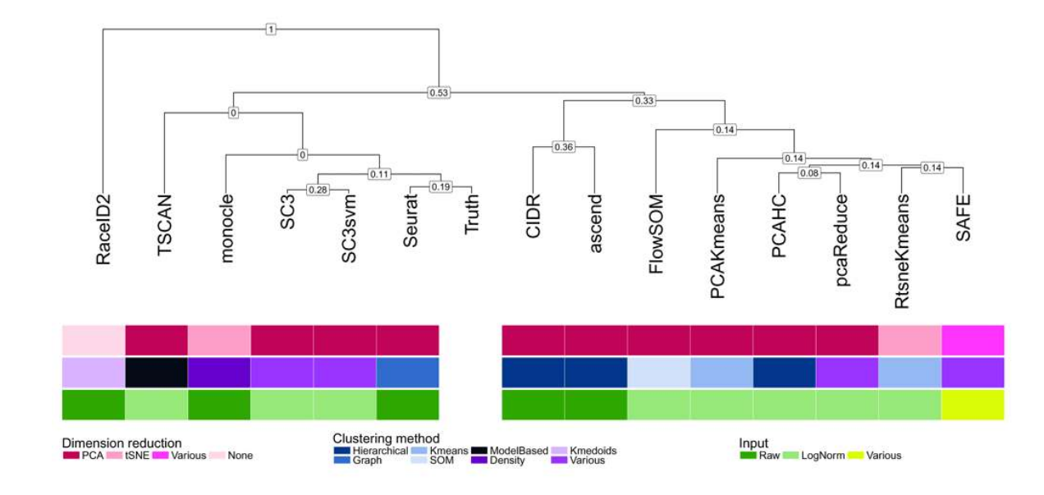
Clustering methods: Benchmarking
Duò A, Robinson MD and Soneson C. A systematic performance evaluation of clustering methods for single-cell RNA-seq data [version 2]. F1000Research 2018, 7:1141 (doi: 10.12688/f1000research.15666.2)

Slide 42
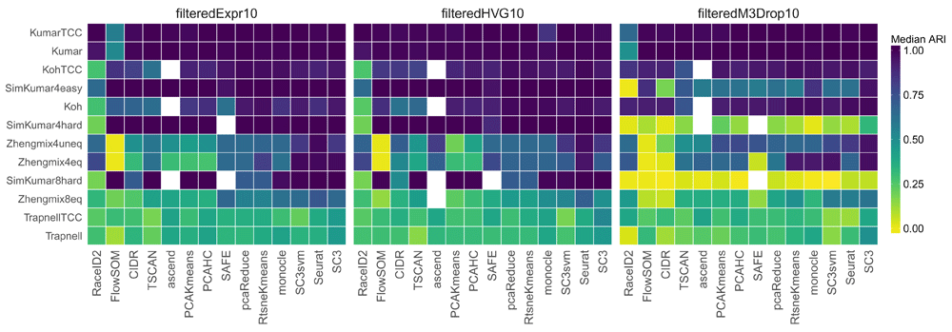
Clustering methods: Benchmarking
Duò A, Robinson MD and Soneson C. A systematic performance evaluation of clustering methods for single-cell RNA-seq data [version 2]. F1000Research 2018, 7:1141 (doi: 10.12688/f1000research.15666.2)

Slide 43
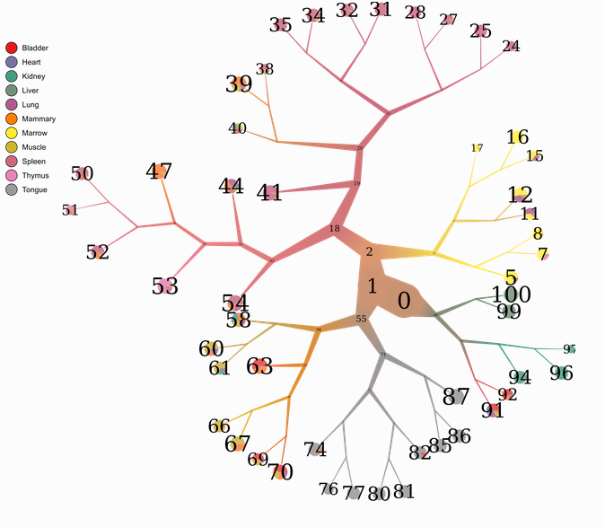
Clustering methods: Too Many Cells
Using Divisive hierarchical spectral clustering.
Alternative visualisation
Easier to see the similarity between different cluster.
Easier to identify rare subpopulations.
Gregory W et Al TooManyCells identifies and visualizes relationships of single-cell clades, bioRxiv January 2019

Slide 44
6.
Differential Expression.

Slide 45
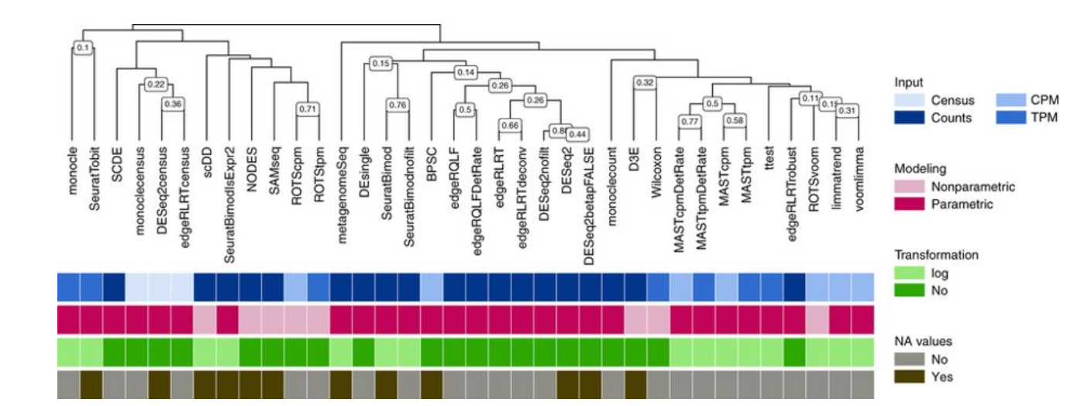
Differential Expression: Benchmark

Slide 46
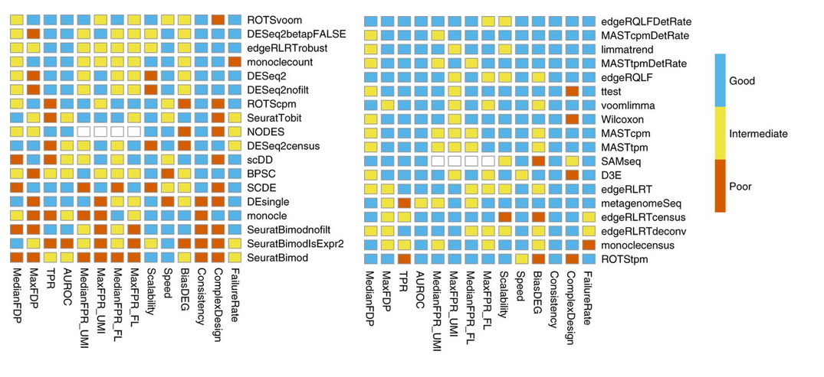
Differential Expression: Benchmark

Slide 47
7.
Trajectory Inference.

Slide 48
Trajectory Inference

Slide 49
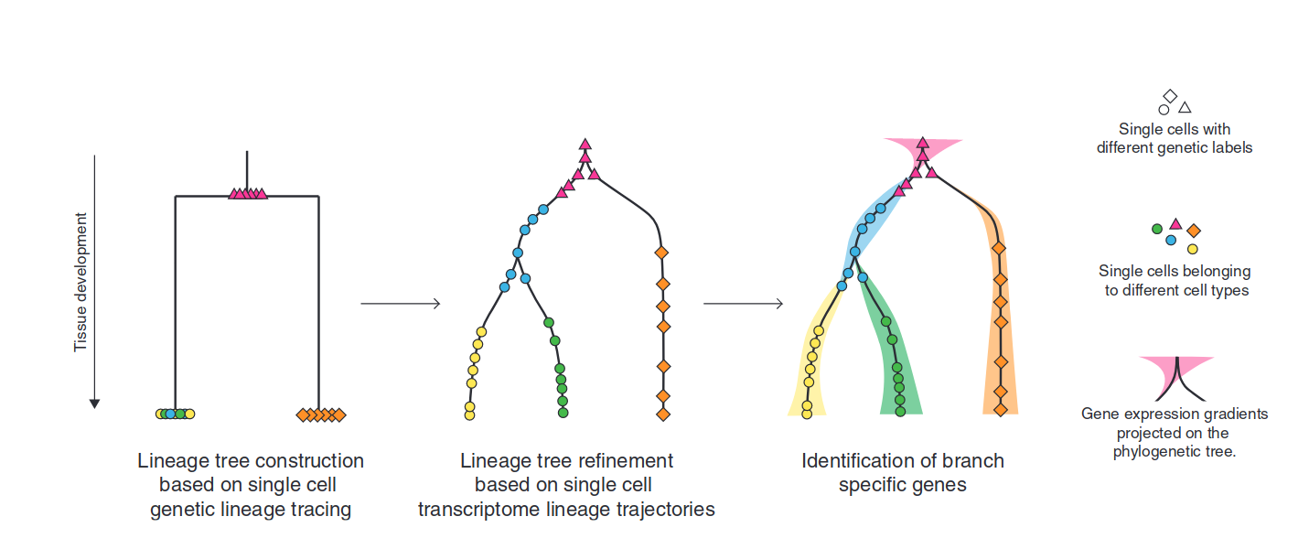
Trajectory Inference : Concept
Kester, L., & van Oudenaarden, A. (2018). Single-Cell Transcriptomics Meets Lineage Tracing. Cell Stem Cell, 23(2), 166–179. https://doi.org/10.1016/j.stem.2018.04.014

Slide 50
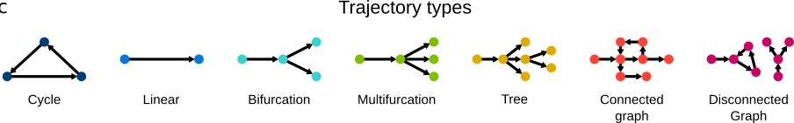
Trajectory Inference : the different lineages types
Wouter Saelens et Al (2019). A comparison of single-cell trajectory inference methods. Nature Biotechnology.

Slide 51
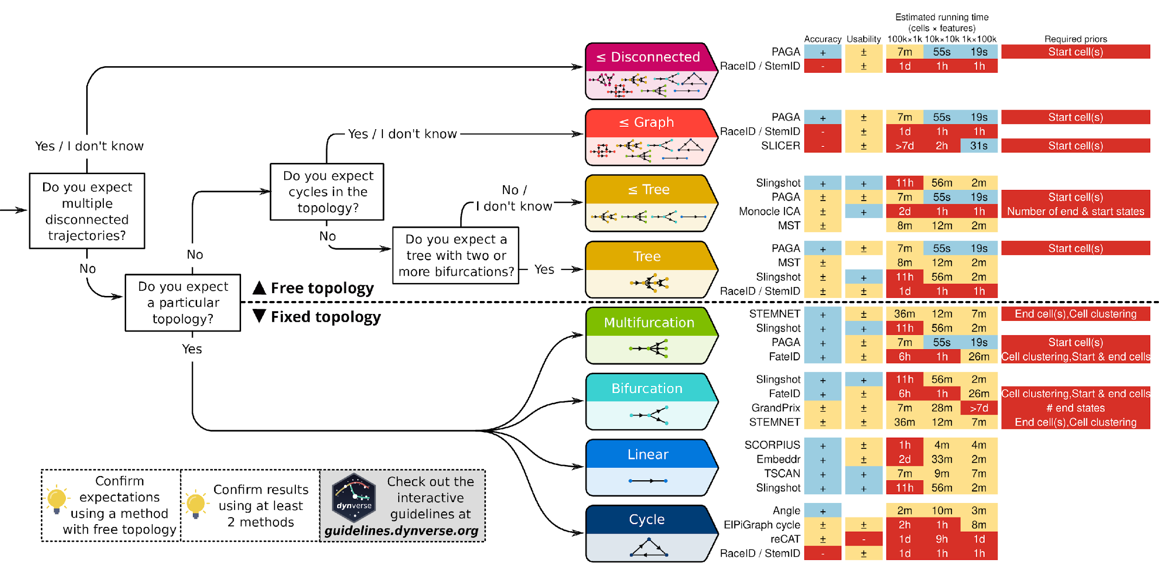
Trajectory Inference : Dynverse
Dynverse Package:
Encapsulate more than 30 existing trajectory inference methods.
Tools for benchmarking the different methods on a particular dataset.
Wouter Saelens et Al (2019). A comparison of single-cell trajectory inference methods. Nature Biotechnology.

Slide 52
8.
Batch Effect Correction.

Slide 53
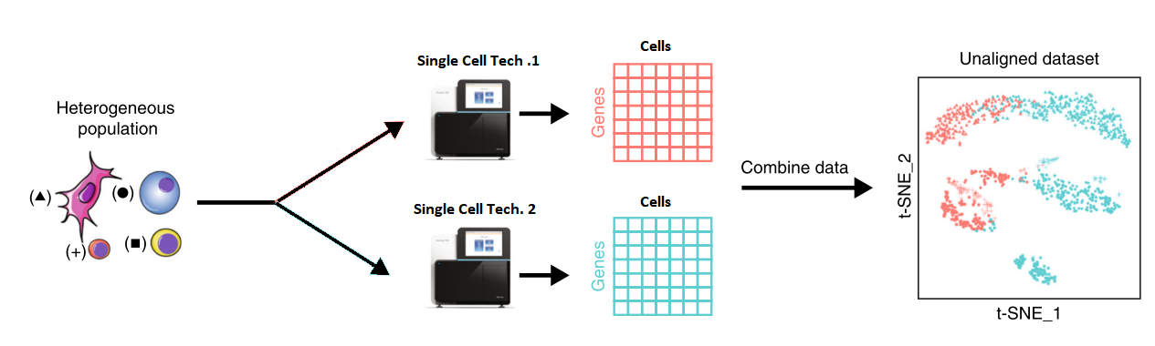
Batch Effect in Single Cell
Sequence small amount of cells
But good gene coverage.
Sequence large amount of cells
But low gene coverage.

Slide 54
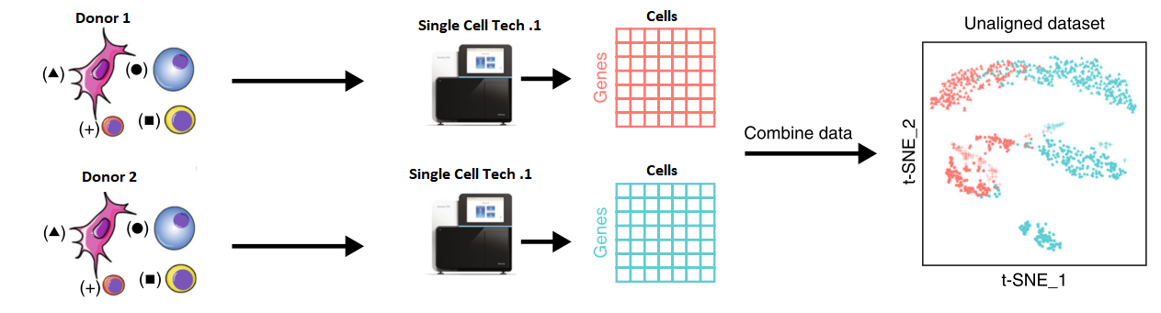
Batch Effect in Single Cell

Slide 55
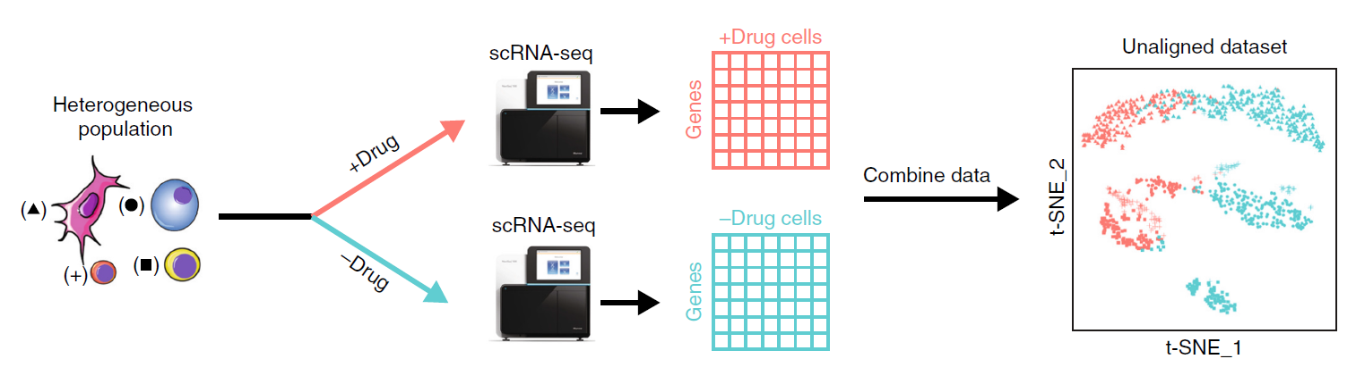
Batch Effect in Single Cell

Slide 56
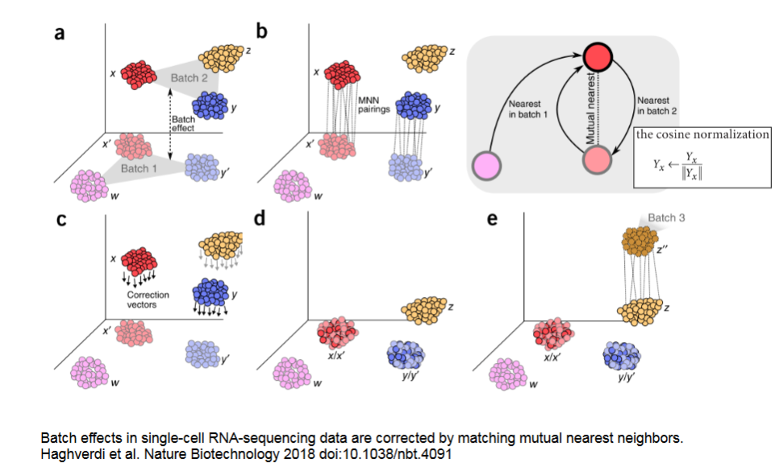
Batch Effect: Correcting batch effect with MNN

Slide 57
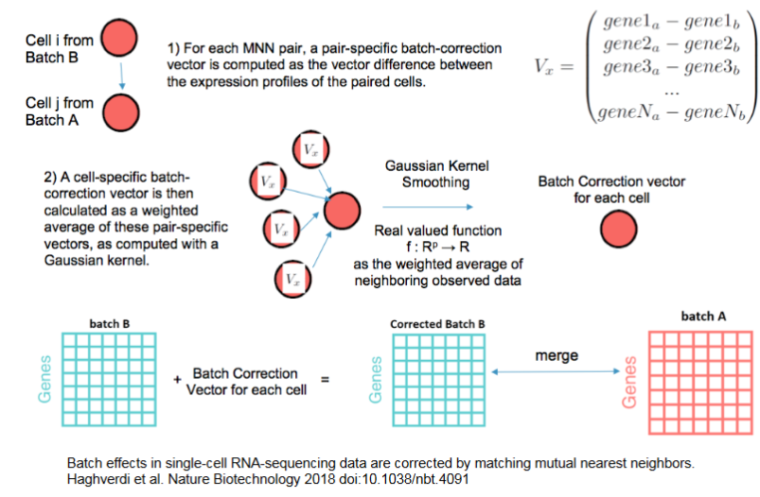
Batch Effect: Correcting batch effect with MNN

Slide 58
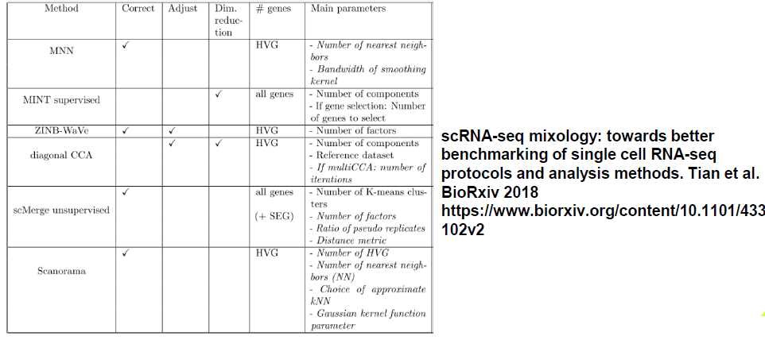
Batch Effect: Other Methods

Slide 59
9.
CellID: novel method for single cell gene set extraction

Slide 60

CellID: The Input
Cells
Cells annotation
Technical Noise
Biological Noise
NOISY!
Keep informative part of variability…
…While discarding noise
48

Slide 61


CellID: Multiple Correspondence Analysis in SCRNASeq
Cells
Cells annotation
MCA
PCA
Cells Space
MCA
Genes Space
49

Slide 62

CellID: Identification of Subpopulations
Clustering
Kmeans
Hierarchical clustering
Model clustering
SC3
SIMLR
50

Slide 63

CellID: Identification of Subpopulations
cell space
The more a gene is close to a cell, the more specific to this cell it will be.
gene space
50

Slide 64

CellID: Identification of Subpopulations
Cluster centroids projection
51

Slide 65


CellID: Identification of Subpopulations
FCER1A
MPO
Identification of biomarkers
FOXO1
CA1
52

Slide 66




CellID: Coupling MCA with GSEA
The more a gene is close to a subgroup…
… the more specific it is to this particular group
The more a gene is distant to a subgroup…
… the less specific it is to this particular group
We can then have a ranking of the specificity of a gene to a particular group.
This is perfect for gene set enrichment analysis.
Identification of biomarkers
53

Slide 67

CellID: Identification of Subpopulations
Identification of biomarkers
54

Slide 68

CellID: Identification of Subpopulations
Identification of biomarkers
55

Slide 69

CellID: Multiple Correspondence Analysis in SCRNASeq
56

Slide 70

CellID: Gene Set Extraction Per Cell
57

Slide 71

CellID: Single Cell GSEA
58

Slide 72

CellID: MCA significantly similar to PCA
B
A1: MCA cell space
A2: PCA
A3: MCA gene Space
A4: MCA both Space
B : Spearman Correlation
Between PCA coordinates and MCA coordinates
59

Slide 73

CellID: Cell gene ranking takes in account dropout effect
CellID Gene Ranking
60

Slide 74


CellID: Cell gene ranking takes in account dropout effect
Naive gene ranking
Important genes for the concerned cell
61

Slide 75

CellID: Application on Coord Blood Data with immune cells signatures
Coord Blood Cite-Seq Data.
Cluster are determined with protein markers.
62

Slide 76

CellID: Application on Coord Blood Data with immune cells signatures with Hypergeometric Test
63

Slide 77

CellID: Application on Coord Blood Data with immune cells signatures with GSEA
Performance is highly relying on the quality of the geneset.
64

Slide 78
CellID: Application on Coord Blood Data with immune cells signatures
Immature immune cells.
65

Slide 79



CellID:
66

Slide 80

CellID: Using MCA coordinates with other dimensionality reductions.
67

Slide 81

CellID: Using MCA coordinates with other dimensionality reductions.
68

Slide 82



CellID: Benchmark with other methods
Reference Pancreatic Dataset
Target Pancreatic 1
Target Pancreatic 2
69

Slide 83


CellID: Benchmark with other methods
70

Slide 84

CellID: Benchmark with other methods
71

Slide 85

CellID: Benchmark with other methods
Accuracy
Accuracy
74

Slide 86


CellID: Benchmark with other methods
Target Data 1
Target Data 2
72

Slide 87


CellID: Benchmark with other methods
Target Data 1
Target Data 2
73

Slide 88

CellID: Pancreatic cellsBenchmark with other methods
Instead of using cell types gene set, pathways describing biological functions can also be used.
Here we show the top pathways for each cell type in the reference data set.
75

Slide 89

CellID: Pancreatic cellsBenchmark with other methods
Instead of using cell types gene set, pathways describing biological functions can also be used.
Here we show the top pathways for schwann cells in the reference data set.
76

Slide 90
CellID: Features and Availability
Unbiased extraction of gene set per cell or per group.
Test a collection of pathways or any gene set on 10000 cells in approximatively 5 minutes.
Usable directly with Seurat or SingleCellExperiment Object
Integrated Shiny App for visualisation
Open source package and preprint will be released end August
76

Slide 91
Thank you for your attention

